Slide 1
Using touch screen devices for cognitive research
Nick Taptiklis

Slide 2
Agenda
Background: Measuring cognition before touch screens
Three case studies illustrating how touch-screen technology can be used to uncover new behavioural insights from fine-grained finger-tracking and to measure at scale and frequency in the real world.
Data coverage from active touch-screen assessments vs passive wearable data collection

Slide 3
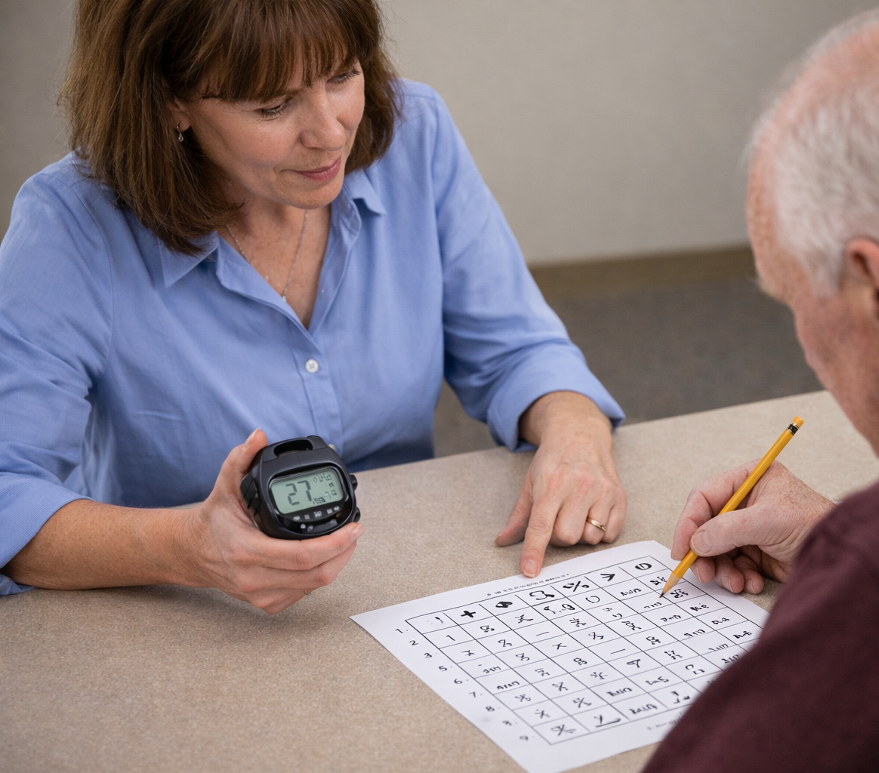
Measuring Cognition before touch screens
Administration: Paper-and-pencil tests, verbal instructions, manual scoring
Training required: Highly trained neuropsychologists / clinical psychologists
Time burden: 1+ hours per patient
Scalability: Poor – resource-intensive, costly, difficult for large studies
Accessibility: Restricted by clinician availability and clinic setting

Slide 4
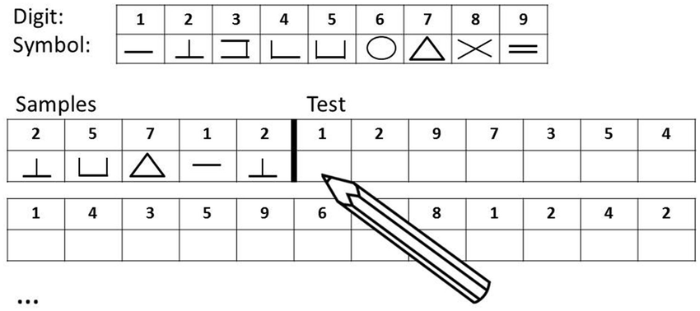
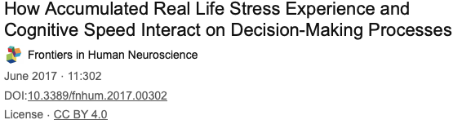
Case Study 1: Digit Symbol Substitution Task
The Digit Symbol Substitution Test (DSST) is a very brief paper-and-pencil task where people match numbers to symbols as quickly as possible
Widely used cognitive tests in research and medicine, with hundreds of publications across aging, dementia, depression, schizophrenia, brain injury, drug effects, and many other conditions, because it is fast, language-light, and highly sensitive to cognitive change.
The outcome measure is the number of correct symbols written in 90 seconds.

Slide 5
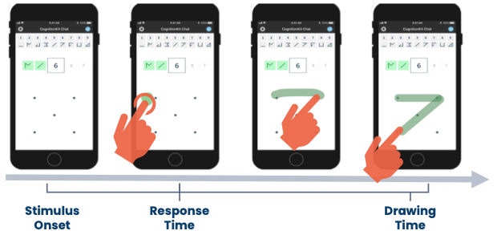
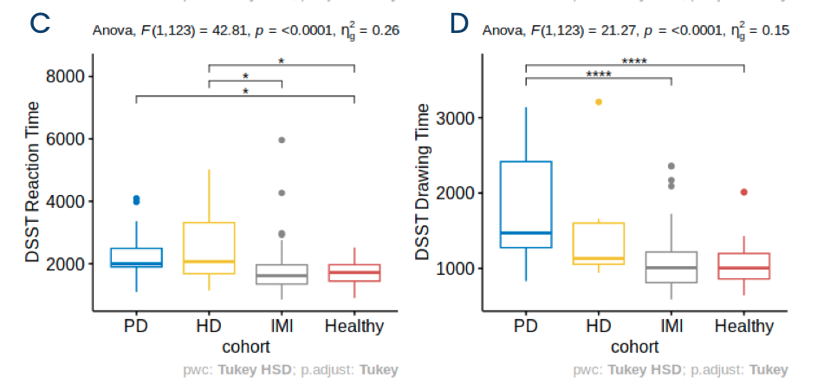
Case Study 1: Digit Symbol Substitution Task
We have developed and validated a digital variant of the DSST which requires participants to draw the responses to the corresponding number. This enables the capture not only total correct responses, corresponding to the pencil and paper version, but also detailed timing information including the onset of the response and the time taken to draw the shape.
This detailed timing information may provide additional insights in the factors driving performance on this task, and potentially the ability to differentiate motoric from cognitive aspects of the overall score.
For example, we have observed differences in the reaction time vs drawing time between Huntingdon's disease and Parkinson’s patients.
The rich tracking information available in touch screen devices enables fine-grain distinctions in behaviour not visible from the course-grain pencil and paper measurement.

Slide 6
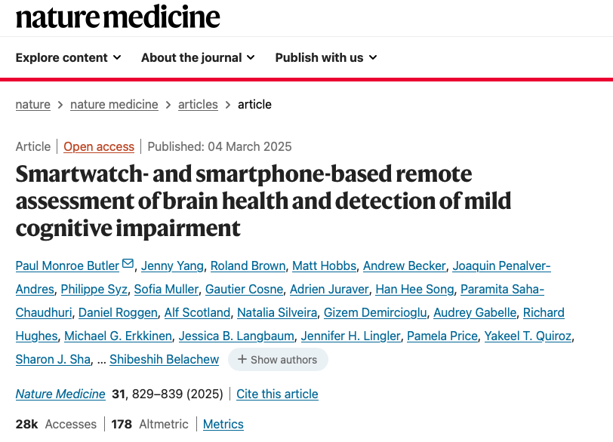
Case study 2: Intuition
Project Intuition Study Overview
Scale: 23,004 US adults aged 21-86 years enrolled (September 2021 - March 2023)
Duration: 24-month observation window per participant
Technology: Custom iPhone app + Apple Watch for multimodal data collection
Active assessments:
Monthly 30-minute CANTAB cognitive batteries
Quarterly high-frequency "burst" testing (3x daily for 2 weeks)
Passive monitoring: Continuous collection from routine device use
Time commitment: ~1 hour per month for active tasks
Data types: Cognitive assessments, self-reported health, routine device metrics

Slide 7
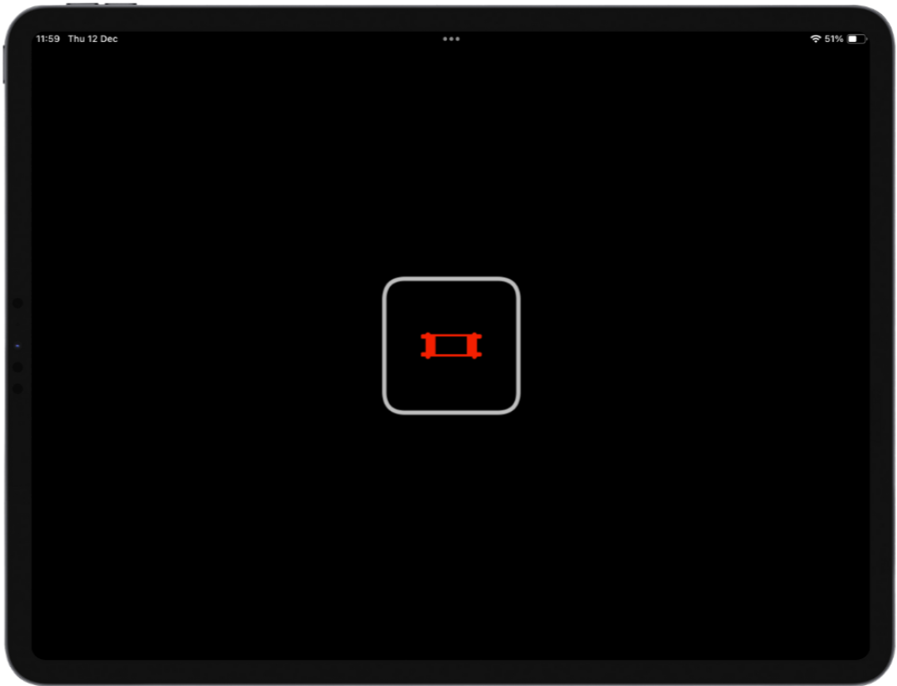
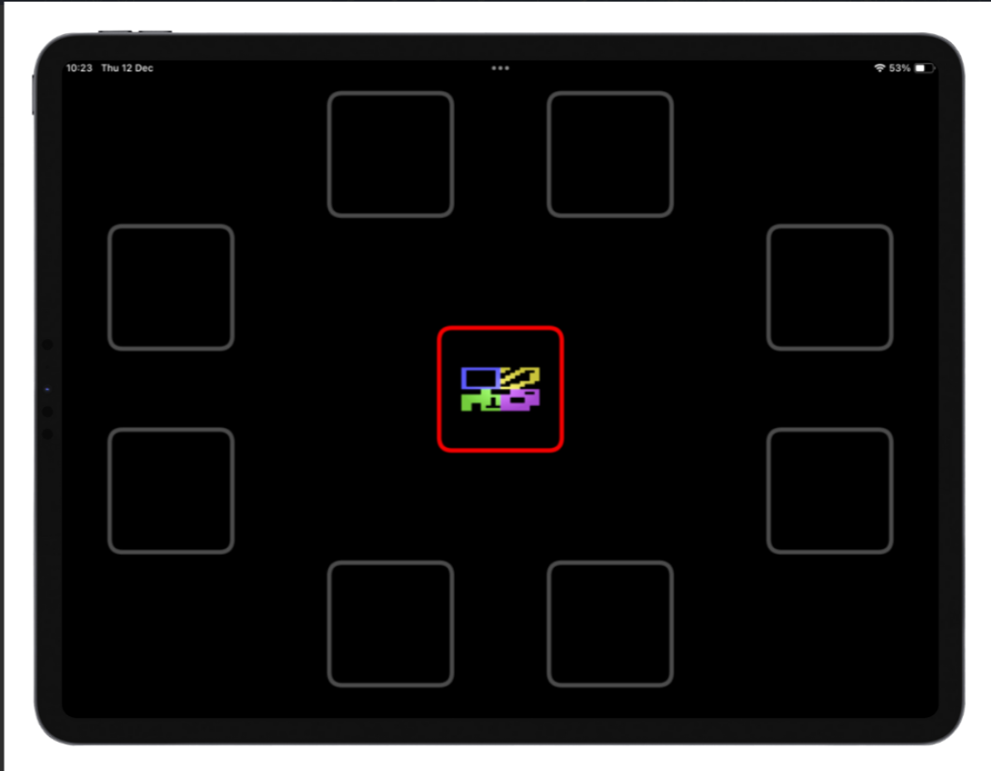
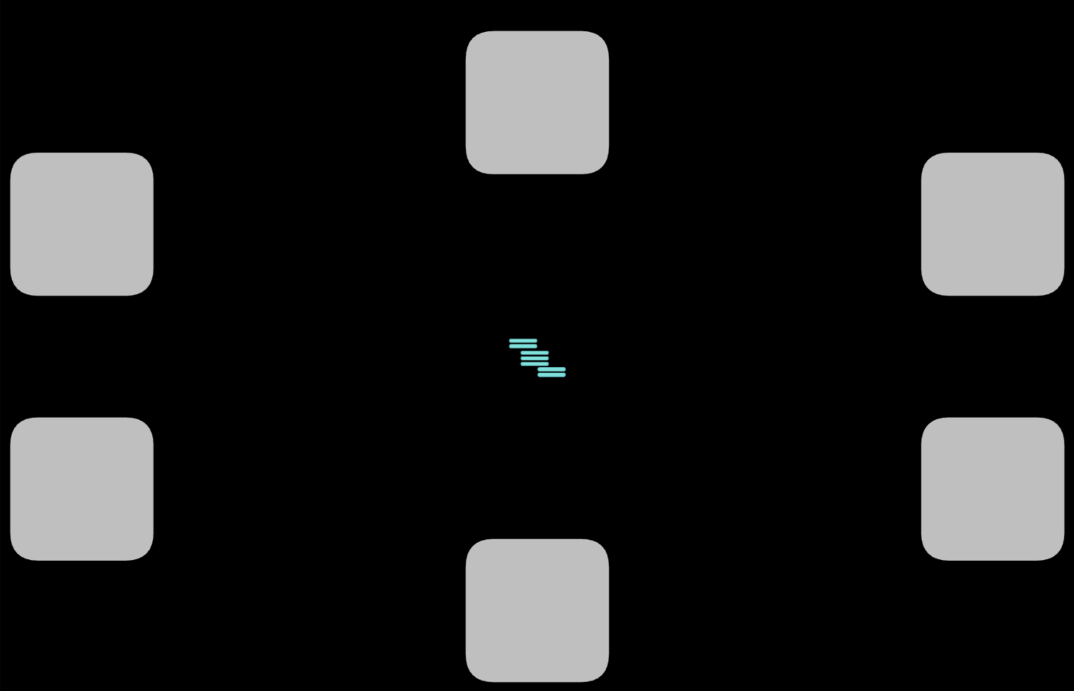
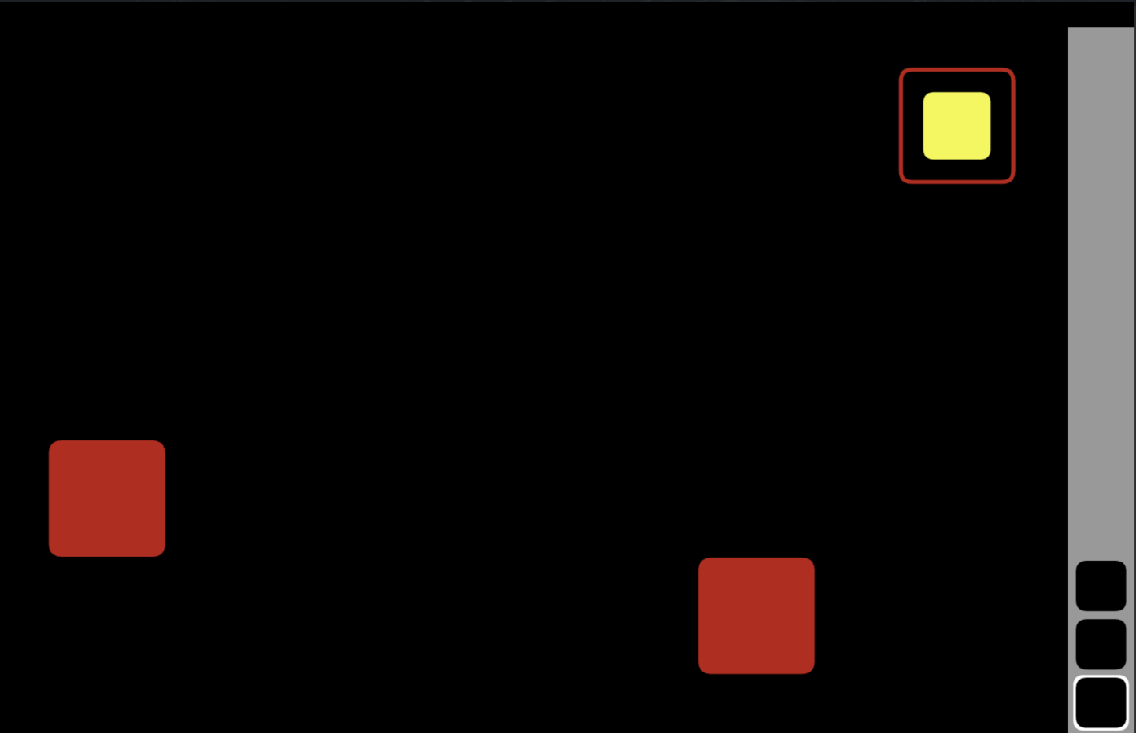
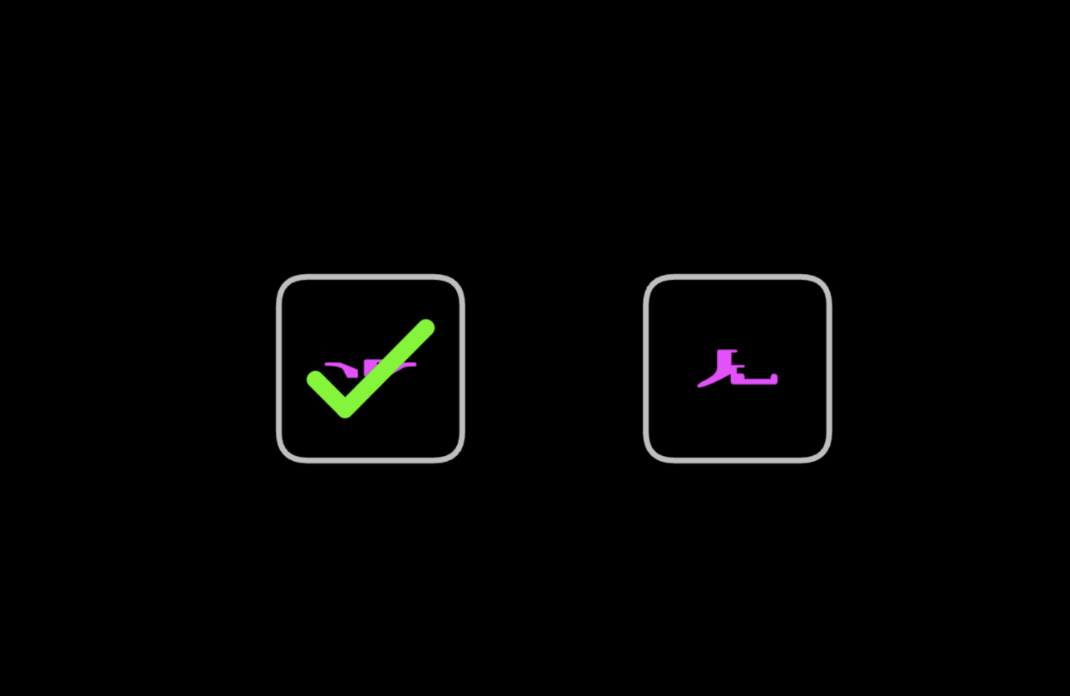
Monthly 30 minute multi-domain battery
Pattern Recognition Immediate
Paired Associate Learning
Matching to Sample
Spatial Working Memory
Pattern Recognition Memory Delayed

Slide 8

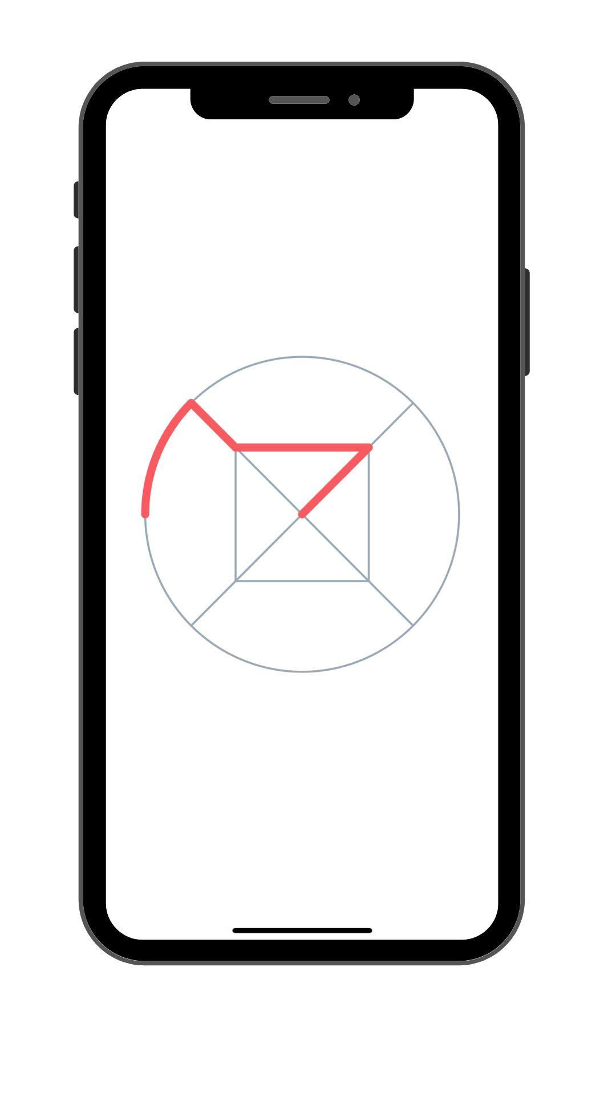
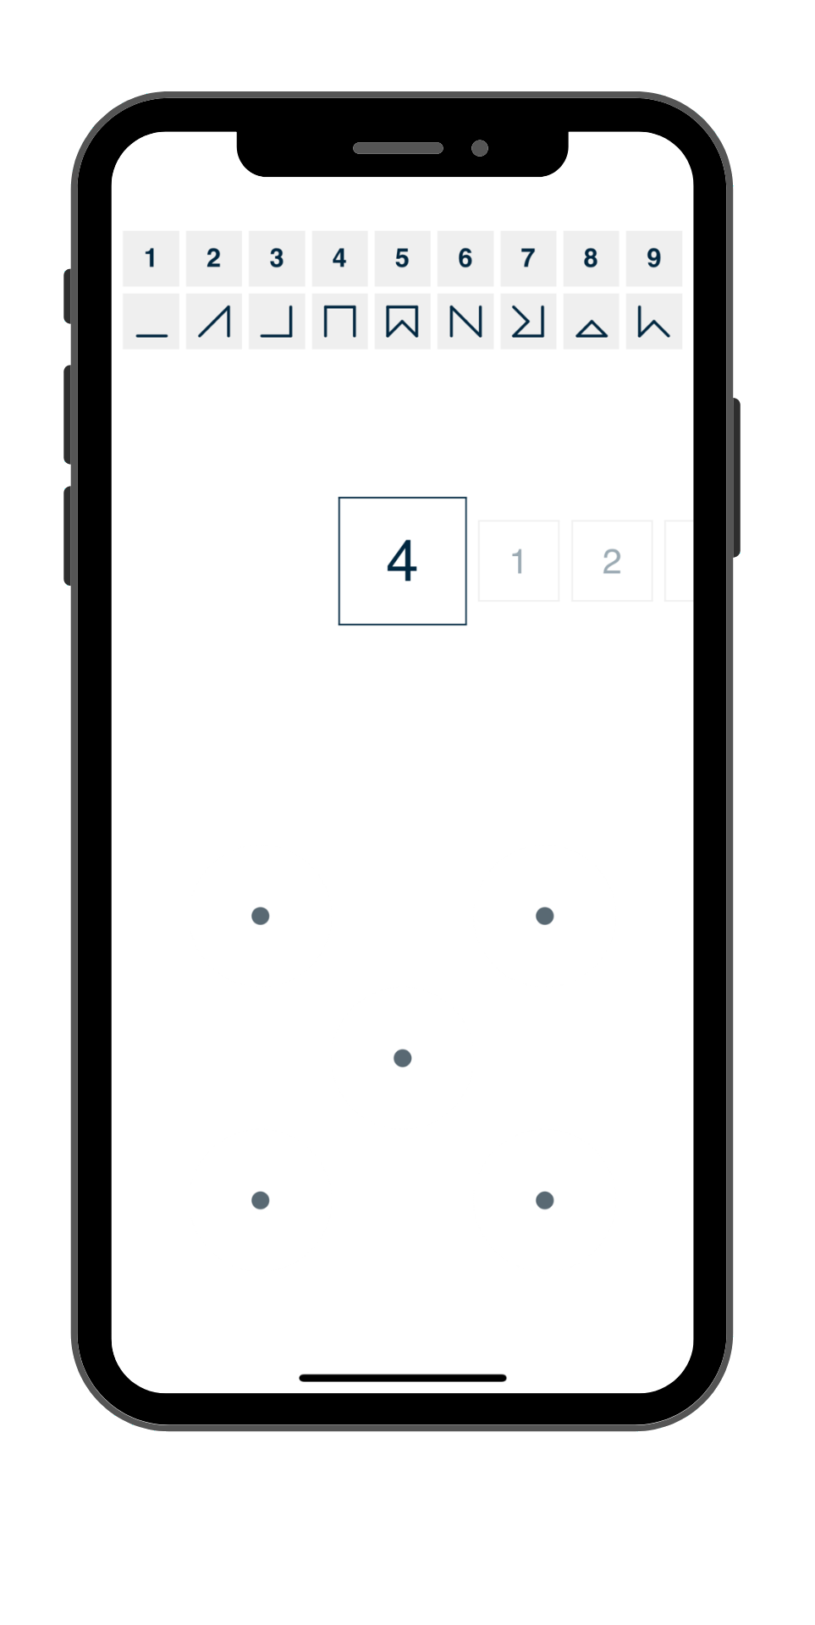
Burst Assessments
N-Back
Digit Symbol Substitution

Slide 9
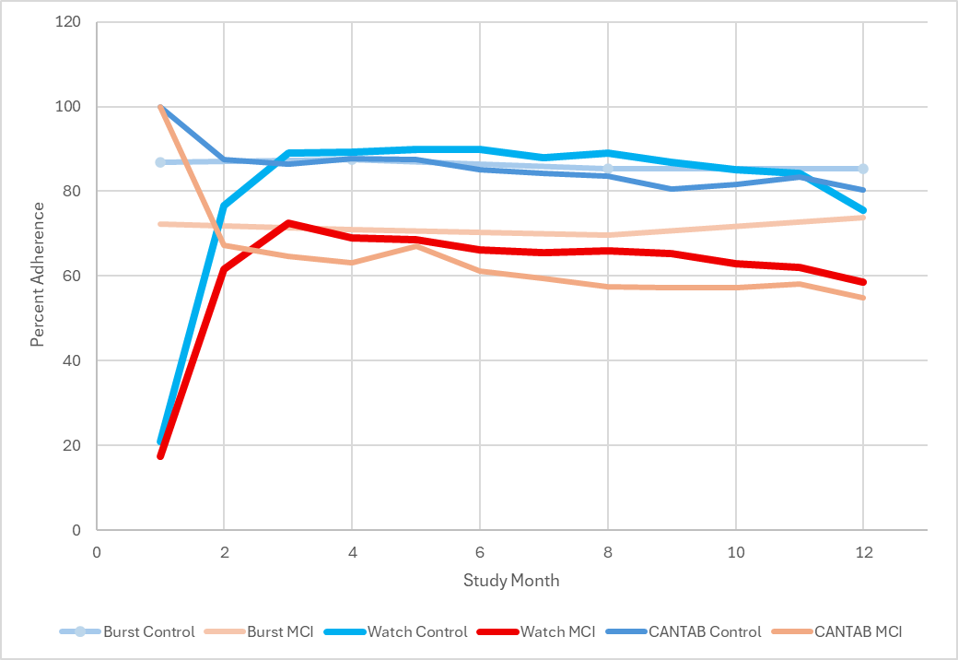
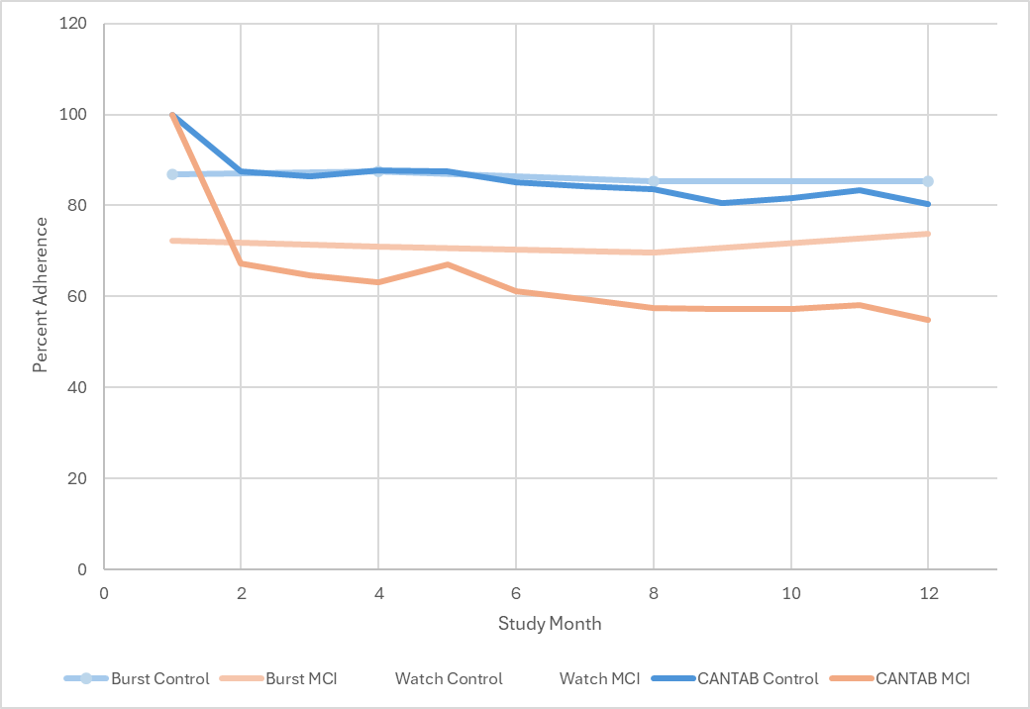
Adherence
Controls aged 60–86 years (n=12,505)
MCI - Individuals self-reporting or clinically confirmed MCI aged 50–86 years (n=883)
30 Minute multi-domain battery adherence similar to Apple Watch wear adherence

Slide 10

Case study 3: IDEA-FAST Clinical Observational Study
IDEA-FAST attempts to makes patients’ lived experience visible, by developing digital measures to capture fatigue and sleep objectively in daily life and bring them into clinical research and care.

Slide 11
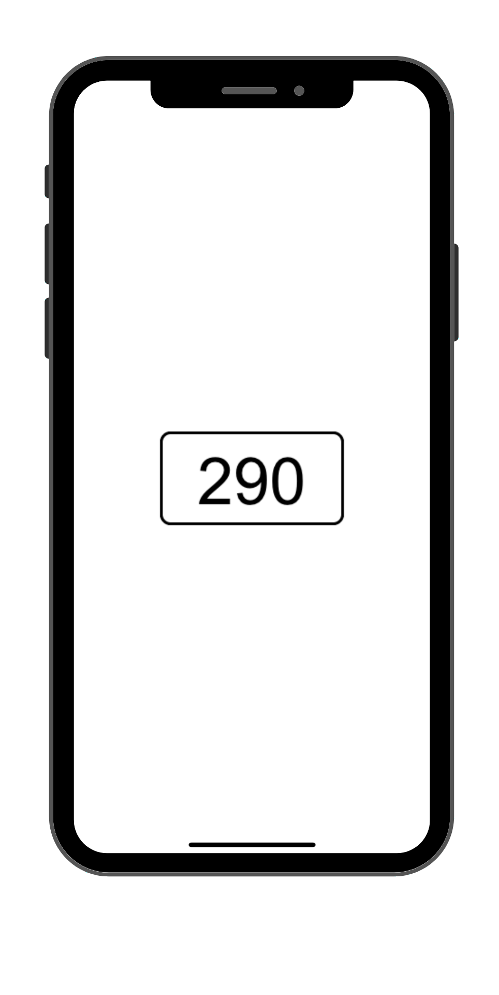
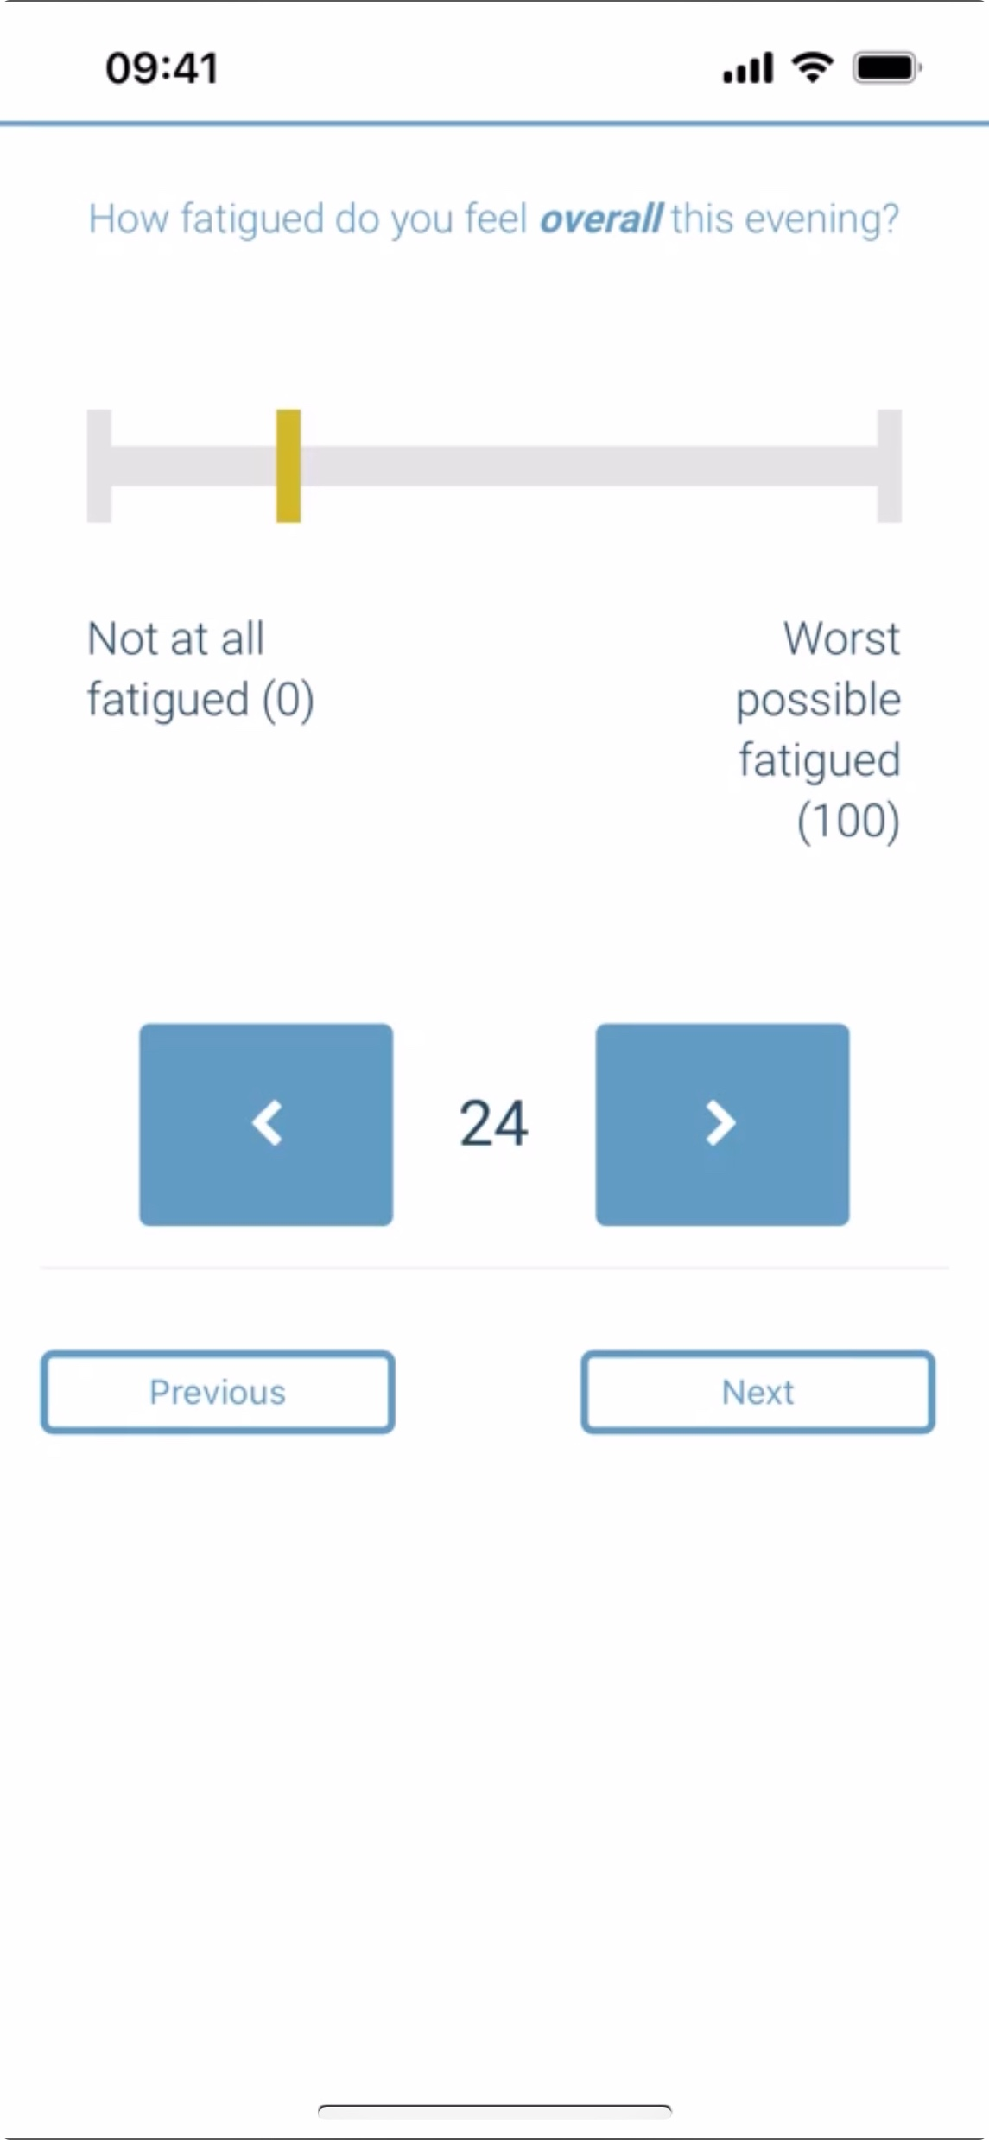
IDEA-FAST Clinical Observational Study
Cohort | Recruited
Parkinson’s disease (PD) | 547
Huntington’s disease (HD) | 147
Inflammatory Bowel Disease (IBD) | 462
Rheumatoid Arthritis (RA) | 174
Systemic Lupus Erythematosus (SLE) | 172
Primary Sjögren’s Syndrome (PSS) | 174
Healthy volunteers (HV) | 215
24 Weeks

Slide 12
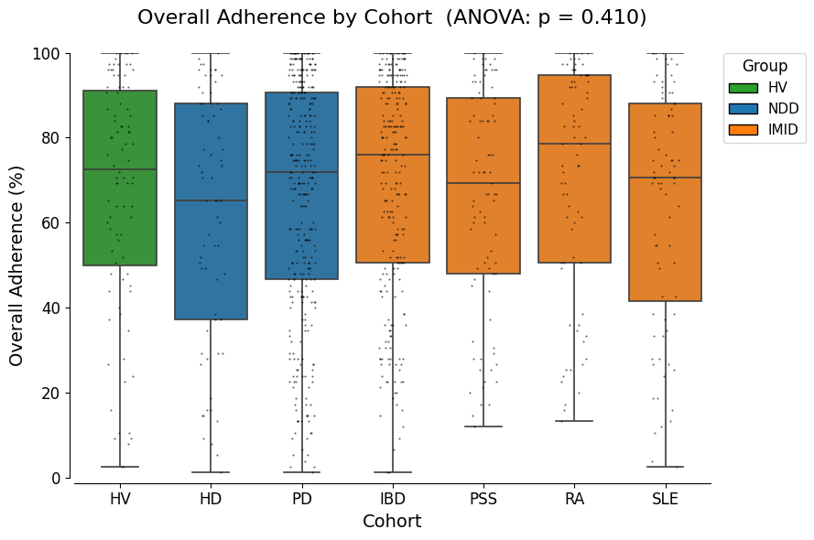
Does disease group impact adherence?

Slide 13
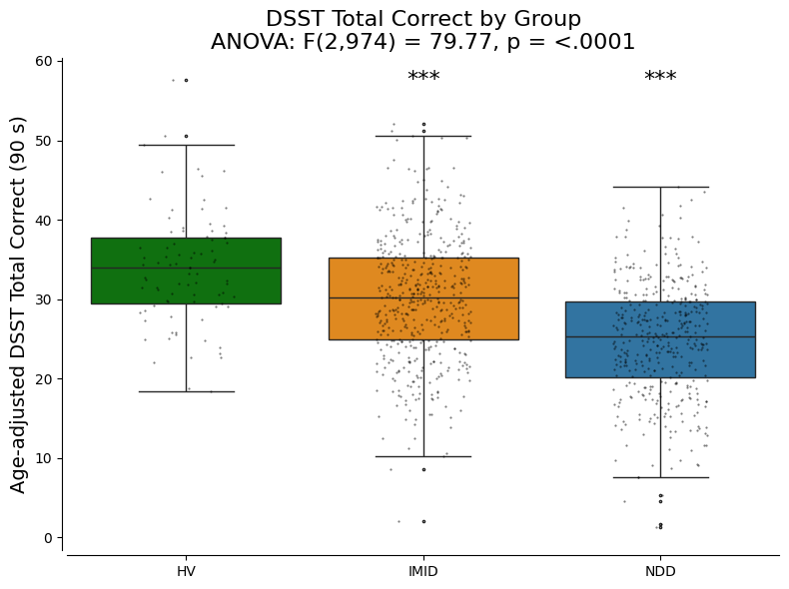
Are the cognitive assessments sensitive to disease?
Performance in Digit-Symbol Substitution Task
The cognitive tasks show strong between group differences
Auto-immune patients show almost half the impairment of neurology patients
These data highlight that significant cognitive impairments exist in non ‘CNS’ diseases
One-way ANOVA on age-adjusted DSST Total Correct:
F(2,974) = 79.77, p < .0001
Post-hoc Welch t-tests vs Healthy Volunteers:
IMID vs HV: Δ = -3.8 (95% CI -5.4 to -2.1), t = -4.45, p <. 001, Cohen’s d = 0.49
NDD vs HV: Δ = -9.0 (95% CI -10.6 to -7.3), t = -10.53, p < .001, Cohen’s d = 1.24

